Slide 1

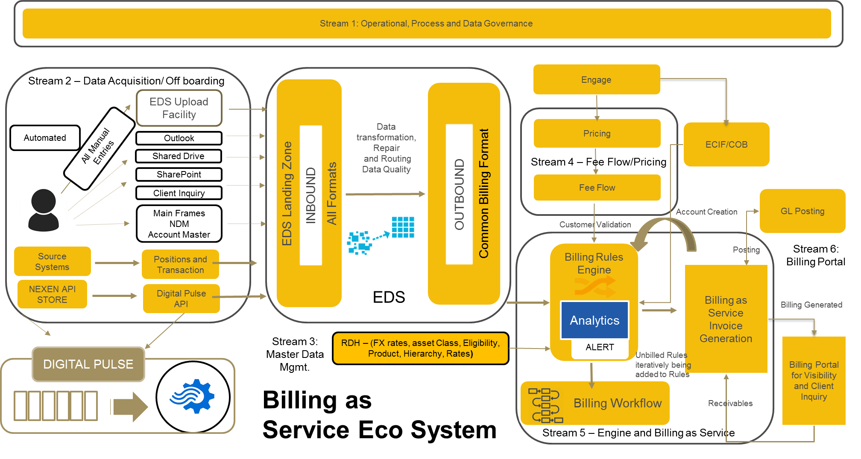
Billing Future State Architecture September 18, 2017
DRAFT

Slide 2
Executive Summary
DRAFT
1. Current Challenges:
Business Challenges
Lack of Business Transparency due to historically non-standard and complex fee-schedules resulting in low client satisfaction
Poor Client Satisfaction, low share of wallet; risk of client retention and revenue leakage
Operational Risk
Manual interpretation of the fee schedules; no integration with client on-boarding; manual intervention to transform and load invoice production data ( 500+ files)
IT Risk due to aging platforms and unsupported ( end of life) software; redundant functionality; excessively complex data flows
2. Ask: Strategic investment over 3 years ( business and technology)
Total projected spend: $30.5 M;
Total unfunded for 3 years = $17.7M
3. Benefits:
Business: realize consistent global billing processes and capabilities across the enterprise leading to increased revenue; improved client service and operational efficiency. Capture revenue leakage of $10 – $15M per annum
Operational Risk Reduction : reduction of manual processes, spreadsheet processing and spreadsheet related errors.
Platform Efficiency: simplification/rationalized architecture and infrastructure; lower cost for development and maintenance; smaller IT footprint; eliminate billing silos; integrated billing systems globally

Slide 3
Application Interaction Diagram – Current State 2017
ATT EPI FTS GSP MMD WST YTE
ALM ARN BLA CFC CRM CRW DSO ED5 ERC GLR GTS ODA PEP PFN PRS WPC WSS YFS YHM ZMD
BDC BWH CAS CDD CDW CFC CIA CIP CIT CPC CPR DDB DFG DMC EPH FNI FSA GPS GSC GSF GTS IHE MDO MMD NSF PSS RBI RMB TWG TWS YAH YBS YCK YCV YCW YDR YGM YLA YLR YLX YLY YNA YNR YTE ZFL ZMM
GMR SEI
XBC YHU
CDS FIX RAP SMD YEE YHC YLX YMV
NAO
YFS
YEM
BAD DAL FIX
RAP
WST
AFS
CDS FTS MFA MFW YAA
YED YPV
EPI
YMN YKS GDP CFT
MFA
FIR
ALM CFC ED5 ERI GLN ICH PRS RDH
SNC WPC YAH YDW YLJ
FRR
LIQ
SNC
BEP INX MMD RBD SII
SMD XPH XTS YBY YEE ZEV ZFM CDW CIW CLX DOR DUS FLW MFW RPO RSV RTG RUF
FRA
CAP
FLW
ACS
BON
DSE
CDW
CBS
RBD
ADR AFS CFD CLX CRK CRW GCR GFC GTS LMS MMD WST YFS
ACT ALS ATC CIA CPR AUD BAI BCA CIP CRW BWH BWI CDS CIT CSC CSF CSI CUE DCS DSE EPH FMT FTS FXY GDP GFC GPS GSF GTX OCH INX ITM MRV MSA NAX PRS QSS RAP RBI RMB RPX SNC SPS TLX TQI WST YED
COF
ED5 FRA MMD NUA RGS YKS ARN AVJ
CAS CDS ITR
YFH YHU
AFS ATT CFC MMD CNP CRK GSP GTS KYC
AFS ED5 QSS XAA XHL YAH YBQ YEC YHC YKC YLN YMV
YPR YRH ZOR CRM ITM SFH XBC YAA YAM YDW YGM YIB
YKS YLZ YNR YQT ZMD ZTF
YAA
AIM
CIF
YMN YTA
BRM CLD MMD ZNF CAS FRA
NEX CDS ITR
ZDD
WSV
BDM CFI GTX NTA
PPS QSS SLL TAS YFH
YHU
ZEF
(ECIF)
CWS
YRH
DDB EDM PNY
CFL CHX EMG FTS GSC GSF ICH IMC LOK MCD NSF RMB TRI WSS XNN YCK YCV YHC YLA YLX YNA YQT
ED5
EDI
IVS PRA
FNG
XNS AP1
ALM BWH CFL CRW EWH RDH XTP CSI FCM TRI YSE ERI GCS WPC ZFD
CMZ
UCF IVR YQT
BIA FIX RFN RUF YBY ZQC
CIL
YAG
CAS CDS DMC FIX FTS GPS RSV
ARN CFC
DMC ED5
ASI
CHX
EPI GSP IMS
YHC
YTE
SVN
MMD
CFT
URM
LBX CSF
DLR
ICI
SQN
ARN ED5 EDI ERR PFN YCV YKS
YSC
KAR
YAC
CDS CPC MMD
NDM YMV YTE
ZMD
YKS
CSC
CCW
CDS CFC
IIS
CRF
CDS CDW
XAJ
PSS GSP
ICR
CDS CFT FTS
ITM LPO QSS
CBV
XNZ
LAR
RGS
EBW
CCS CFL
CSF CSI
NSF TRI
CDS CSC
YED YMN
CAS YKS
YBM YBY
BRR
EBS YTE
CDS
ASG
GCG
CAE
KFC CFT ITM
CPR
CAS FIX LBX ZNF
ED5 PFN
Source : Business Enterprise Architecture (BEA)
Key Man Risk /EOL:
High
Med
Low
Service :
Revenue
& Billing
Client Master Data
Mgmt

Slide 4
Business Case Analysis
DRAFT
Problem / Opportunity Statement
Goal Statement
Reduce Operation Risk, cost and complexity by eliminating duplicate billing architectures and business processes, while also enhancing revenue billing opportunities.
Effectiveness
Functional improvements
Revenue enhancements ( forecasted $ 10 – 15 mil per year)
Efficiency
Operational improvements
TCO reduction
simplification
Business Transparency: deliver functionality that will provide transparency and operating efficiencies for invoice creation and data validation via a client portal; realize consistent global billing processes and capabilities leading to greater revenue opportunities
Operational Risk Reduction : reduction of manual processes, spreadsheet processing and spreadsheet related errors.
Platform Efficiency: simplification/rationalized architecture and infrastructure; lower cost for development and maintenance; smaller IT footprint; eliminate billing silos; integrated billing systems globally
Business Case
Project Scope
Total estimate investment: $ 30.1m
Forecasted benefits: Revenue efficiency - $10 - $15 per year;
Note: The Project Cost assumes the current Operating budget and Incremental spend
Asset Servicing (Advantage); Corporate Trust (FiRRe); Treasury Services (CAP)
Streams : Process Stream and Data Governance; Data Aquisition; Fee Flow & Pricing; Billing as a Service; Billing Portal
2017 | 2018 | 2019 | 2020 | Total
0.7 | 11.8 | 11.1 | 6.9 | 30.5
Project Team
2017 | 2018 | 2019 | 2020 | 2021 | 2022
0 | 0 | 5 | 10 | 12 | 15
Project Sponsor: Arvi Gujral / Mike Santomassimo
IT Provider: K. Underwood / R. Raman
Program Mgr.: N. Zubenko
Service Lead: V. Wong
Lead Architect : R. Kaveti
SME: Erica Thomas

Slide 5
Target Enterprise Billing Architecture
01 Operational/Process Stream and Data Governance
Defining Standard Invoicing/Billing template for Enterprise
Defining Product/Services/Activities hierarchy for Enterprise
Defining standard Fee flow templates for Enterprise
Defining operating model
Defining standard data governance process and approval process
02 Data Acquisition
Automation of manual uploads
Utilization of enterprise data management services
03 Master Data Management
Master Data Classes Management ( Account Master, FX Rates)
Product Catalog On-boarding
04 Fee Flow and Pricing
Create and Maintain Product Catalog via RDH
Work Flow Capability for approvals
Eliminate manual intervention in the fee schedule setup process
05 Billing Engine/Billing Workflow
Ability to manage Billing Rules
Ability to set up and generate invoices/bills based on Customer Fee schedules
Relationship management for account and invoice group
Workflow/Validation and Approval process
Posting of revenue and accruals to GL
Calculating unbilled and tracking lineage of unbilled
Managing account receivables/Direct Debit Capability/balance earnings
06 Billing Portal
Client Invoice/Bill view
Client Fee Schedule View
Integration of Account Information in Billing Engines
Reports/Dashboard
History of Client Invoices/Fee Schedules
Relationship Management/MyTasks for Client Inquires
Client Inquiry Portal

Slide 6
Business Case - High Level Cost Drivers & Assumptions
DRAFT
Programs assumes a phased implementation approach based on the set of activities identified for 6 Streams . Program also prioritizing the transition from the existing billing systems:
Phase I: Advantage
Phase II: Firre
Phase III: CAP
The target architecture will utilize enterprise utilities for data acquisition and master data management
Data acquisition costs aligned to the volume of source data associated with each billing system
Master Data Management costs assume upfront investment in support of phase I implementation requirements (e.g., product master)
Total projected spend: $30.5 M
Total unfunded for 3 years = $17.7M
Technology Total Unfunded Cost: $ 14.3M(2018 - $5,7M; 2019 – $ 5,3 M; 2020 – $3,1M
Technology Total Incremental HC ask: 54 HC for 2018, expect to stay flat for 2019 and will be able to reduce by 20 HC in 2020
Cost By LOB ($000) | Q4 2017 | 2018 | 2019 | 2020 | Total
Asset Servicing | 700 | 11,745 | 4,458 | 1,728 | 18,631
Corporate Trust |  | - | 1,672 | 1,728 | 3,399
Treasury Services |  | - | 5,015 | 3,455 | 8,470
Total | 700 | 11,745 | 11,145 | 6,910 | 30,500
Prioritized Delivery
Advantage
FiRRe
CAP
Note: The Project Cost assumes the current Operating budget and Incremental spend
Unfunded Cost -Business and IT ($000) | Q4 2017 | 2018 | 2019 | 2020 | Total
Business Cost | 0 | 1,400 | 1,400 | 600 | 3,400
Technology Cost | 0 | 5,900 | 5,300 | 3,100 | 14,300
Total |  | 7,300 | 6,700 | 3,700 | 17,700
Head Count | Q4 2017 | 2018 | 2019 | 2020
Technology HC Unfunded |  | 54 | 54 | 34
Technology HC Funded | 0 | 26 | 26 | 26
Business HC Unfunded |  | 15 | 15 | 15

Slide 7
Appendix
Billing Architecture
Billing Service Risk Review
Application heat map
Future State Functional Architecture
Business case analysis

Slide 8
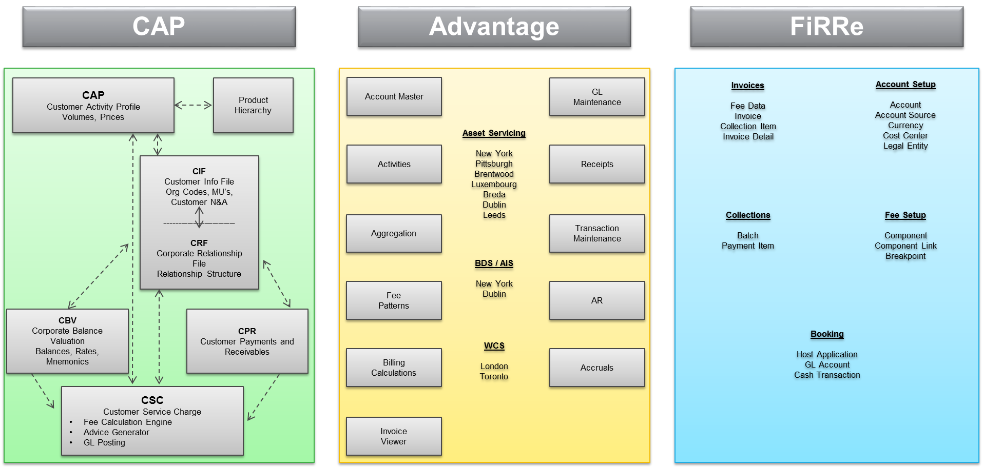
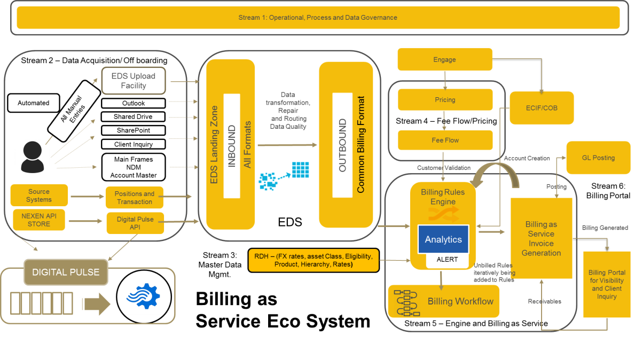
Billing Architecture
From
To
Business Challenges
Low Client Satisfaction, risk of client retention and share of wallet
Lack of Business Transparency
Operational Risk
IT Risk due to aging platforms
Business Benefits
Effectiveness
Business Transparency
Functional improvements
Revenue enhancements
Efficiency
Operational improvements
TCO reduction
Simplification

Slide 9
Application Heat Map - Billing & Revenue Service

Slide 10
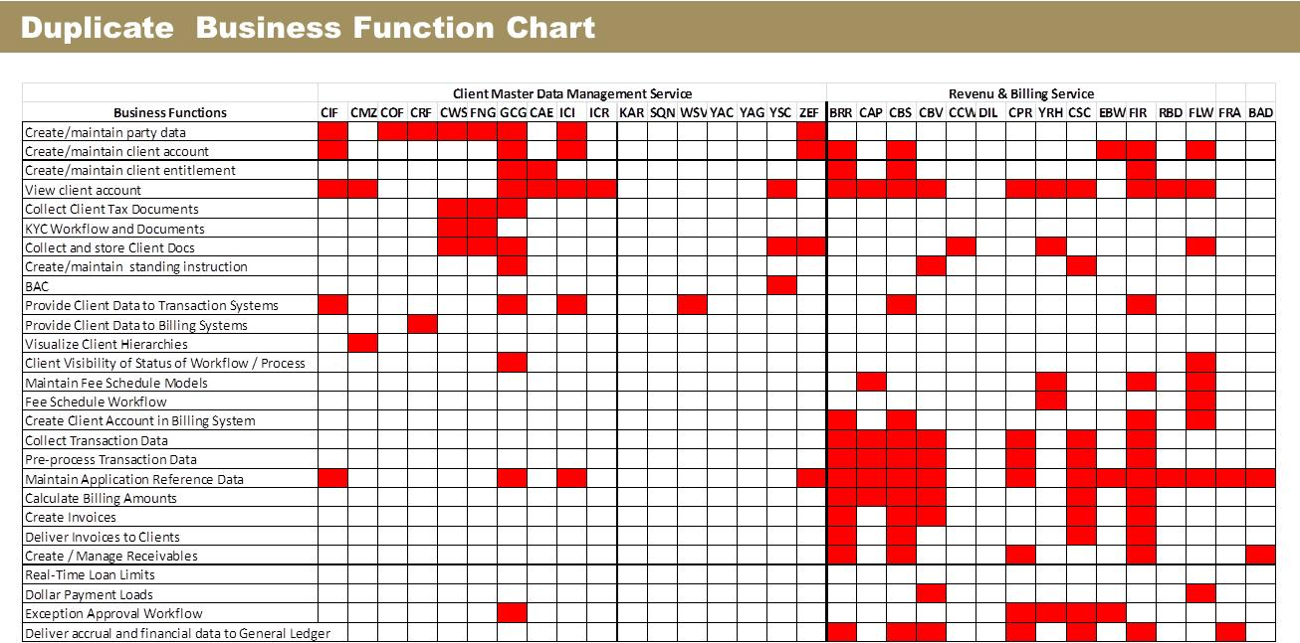

Slide 11
Future State Billing Portfolio Landscape

Slide 12

Target Enterprise Billing Architecture Detailed
External
world
Corporates
FI’s
Correspondent Banks
Insourced Banks
Partner Banks
Client ERP System
Individual Customers
Channels
LOB Specific Customer Interaction Applications
Golden
Sources
TRN
Manual
Collections
References
LOB Specific Source Systems (150+)
Account Receivable
Customer
& Accounts
Markets
&
Asset Classification
Product Hierarchy
(Single
Source)
FX Rate
Manual
EDS
RDH
Fee &
Pricing
Enterprise Data Source
Reference Data Hub for
(FX rates, asset class, eligibility, product, hierarchy, rates, CCY, IPID,
customer A/C, markets etc.)
Fee Flow
(Single Source)
Billing
Engine
Enterprise Centralized Billing Engine
Data
Acquisition
Data
Validation
Billing Events
Aggregation
Price
Identification
Billing
Execution
Simulators
Invoice &
Revenue
Mgmt.
Invoice & Revenue Mgmt.
Tax
Calculation
Invoice
Generation
Invoice
Approval
Invoice
Distribution
Account
Receivable
Direct Debit /
GL Posting
Client
Forecasting
Client
Profitability
Outbound
EDS
(Data delivery to downstream systems)
EDG
(Invoices Repository)
Reports
(Reports Repository)

Slide 13
Proposed Functional Architecture (Billing Functions)

Slide 14
Role based access to Operation Team
Relationship Manager
Administrator
Security Manager
Role based access to Technical Support Team
Billing Events Canonical Format
Billing Portal
Invoice Distribution
Flexible Billing Setup & Configuration
Billing Rule Management
Data Acquisition & Processing
Billing Execution & Invoicing
Other Billing Functions
Portal Functions
Billing Entity
Invoice Entity
Add Rule
Invoice Viewer &
Invoice History
Discount
Management
Adjustments
Reports & Analytics
Tx Reversal
Billing Method &
Cycle Setup
Inbound / Outbound
Change Rule
Tx Correction
Stop / Resume
Invoice Process
On Demand, Rollback /
Re-run
Payment Reversal /
Correction
Unbilled Transaction
Dashboard
Invoice Templates
Invoice Distribution
View / Assign Rule
Tx Deletion
Invoice Cancellation
Backdated & Delayed
Billing Execution
Payment Rejection &
Write-off
Executive
Dashboards
View ERR Tx
Billing Preferences
Metadata Mgmt.
Activate / De-activate
Rule
Approve ERR Tx
Trial / On Demand
Invoice
Invoice Approval
Pricing Model Viewer
and Simulators
Inquiries & Searches
Reference Data
Financial Processing
..
Billing Entity Setup
Invoice Entity Setup
Invoice Template Setup
Invoice Distribution Setup
Billing Rules Setup
Currency & Calendar Setup
Import & Export Setup
Multi-lingual & Multi Currency
Role based Access Setup
Flexible Billing Configuration
Bill Method Setup
Data Acquisition
Data Quality & Process
Billing Execution
Invoicing
Account Receivable
Other Billing Functions
Portal & Analytics Func.
Transactions
Transaction Validation
Cyclic Billing Run
Invoice Generation
Full / Partial Collection
Dispute & Adjustments
Electronic Invoice
Customer A/C
Transaction Reversal
On Demand Billing Run
Trial Invoice
Batch Collection
Suspense Processing
Unbilled Transactions
Product Catalogue
Transaction Re-Acquisition
Backdated Billing
Invoice on Demand / Manual
Reversal / Cancellation
Predictive Billing
Analytics & Reporting
Payments & Collections
Fee Hierarchy
Transaction Deletion / Correction
Rollback and Re-run
Invoice Cancellation
Rejection / Reminder
Late Fee Processing
Billing Setup & Configuration
FX Rate
Activity Identification
Special Schemas & Discounting Processing
Invoice Approval
Possibility to exclude / Write-off / Forgo
Direct Debit / GL Posting
Billing Preferences
Others Reference Data
Transaction Traceability
Change in Pricing & Missing Prices
Invoice Taxation
Collection Reconciliation
Client forecasting & Profitability
Billing Cycle Configuration
Payments
Backdated / Missing Transaction
Change in Billing Entity Hierarchy
Stop / Resume Invoice
Prepaid Collection Processing
Business Scenario Simulators
Fee & Pricing View
Forecasting & Profitability
Billing Rules
Data Validation Rules
Aggregation Rules
Pricing Model Identification Rules
Pricing Model Application Rules
Discount & Adjustment Rules
Account Receivable Rules
Direct Debit / GL Rules
Billing Execution Rules
Fee & Pricing
End to End Dataflow Reconciliation
Billing Workflow
Analytics & Reporting
Tx Error
Tx Reversal
Billing Rule Add / Change
Invoice Approval
Dispute & Adjustment
Account Receivable
Late Fee Processing
Other Workflows
Alerts / Notification
Metadata Management
Events
Event Management
Data Linage Events
Error Events
Duplicate Data Events
Rejection Events
Account Receivable events
Internal Processing Events
Other Events
End to End Dataflow Lineage
Notes:
Flexible Billing Configuration
Import Configuration
Export Configuration
Billing Cycle Configuration
Application Parameters Setup
Calendar Setup
Flexible Billing Event Logical Grouping Setup
Billing Preferences

Slide 15
COMPLEX FUNCTIONAL USE CASES
Data Loading & Validation
Loading fails for Tx, reference data, fee & payments
Data validation failed
Missing references during validations
Transaction reversal & correction
Flag transaction not to be billed
Data Aggregation & Price Tagging
Change in aggregation rule
Change in price
Change in billing entity hierarchy
Missing prices
Billing Calculation Engine
Change in billing calculation rule
Change in price
Change in billing entity hierarchy
Missing prices
Billing Rollback, rerun and backdated billing
Invoice
Invoice cancellation
Invoice rejection
Invoice re-creation
Payments & Collections
Collection Reversal
Collection rejection

Slide 16
COMPLEX FUNCTIONAL USE CASES
Change in billing entity hierarchy
Tx Load reversal
Tx correction / deletion
Change in billing rules
Billing calculation rollback
Billing calculation rerun
On demand billing calculation
Perform backdated billing calculation
Invoice Stop / resume process
Invoice cancellation process
Manual Invoice creation
On demand invoice
Trail invoice
Special Charges
Discounts
Change in reference data
Invoice approval process
Invoice rejection process
Invoice correction process
Dispute & adjustments
Payments & Collection
Prepaid collection
Bulk collection processing
Full / partial collection processing
Collection rejection
Collection reversal
Collection correction
Collection reminder
Possibility to exclude / write off / forgive

Slide 17
DRAFT
Business Case Analysis

Slide 18
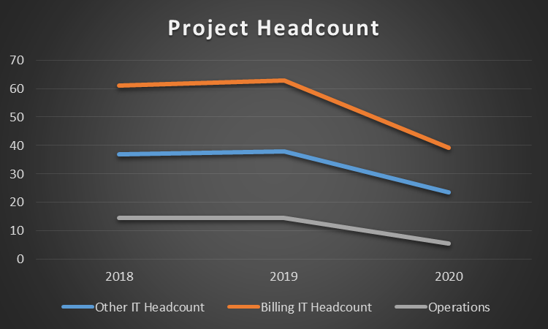
Billing Project Cost and Head Count Estimates
Note: The Project Cost assumes the current Operating budget and Incremental spend
In $000 | Q4 2017 | 2018 | 2019 | 2020 | Total
Data Acquisition | - | 4,725 | 4,725 | 4,050 | 13,500
Master Data Mgmt | 80 | 480 | 240 | - | 800
Fee Flow | - | 1,520 | 1,520 | 760 | 3,800
Billing as Service | 340 | 2,380 | 2,720 | 1,360 | 6,800
Billing Portal | 100 | 1,200 | 500 | 200 | 2,000
Operating Model and Product Mgmt | 180 | 1,440 | 1,440 | 540 | 3,600
Total | 700 | 11,745 | 11,145 | 6,910 | 30,500
Since the target architecture will utilize enterprise utilities for data acquisition and master data management it will assume upfront investment required for phase I implementation
Billing as a Service and Billing Porta components of the target architecture are also assumed to be upfront investments, required for phase I and phase II delivery
Billing IT Head Count:
IT Systems Headcount Breakdown:
Billing Processing Systems: IT Funded – 26 HC; Incremental – 34 HC
Total – 60 HC
Data Acquisition/Source Feeding Systems (220 feeds) : IT funded - 33 HC
IT incremental – 20 HC ( DMA – 8 HC; Source Systems – 12HC)
Total IT Incremental HC ask: 54 HC
Total IT Unfunded Cost: for $ 13 mil (2018 - 5,3 mil; 2019 – 5,3 mil; 2020 – 3,1 mil )

Slide 19
Business Case - Data Acquisition Cost Estimate ( model)
Billing Data Acquisition : assumes a source system complexity split of 60%Low; 25% moderate; 15% Complex
Worst Case Scenario Based on Complexity | Unit | Unit Cost $K | Onboarding | Offboarding +Billing Load | Source Activity Code | Total Cost | Cost per Source
Complex | 18 | 150 | 2,700 | 810 | 540 | 4,050 | 225
Moderate | 29 | 100 | 2,900 | 870 | 580 | 4,350 | 150
Low | 70 | 50 | 3,500 | 1,050 | 700 | 5,250 | 75
Total Cost |  |  | 9,100 | 2,730 | 1,82 | 13,650
Observations to optimize Data Acquisition cost estimates:
Rationalize source inbounds, reducing the number of source files. Many of the source systems provide numerous “specialized extracts” by product or by location (e.g., YLR provides 5 feeds by Lockbox location)
Approximately 27% of the defined sources exist in EDS – leverage or amend existing source systems already registered in EDS. E.g., assume deposit balance information is pulled from CDS for the CAP invoices. If true then the deposit balances already exist in the EDS B&G source feed thus we can eliminate onboarding costs for CDS. SME’s would be needed to validate this type of analysis/assumption.
Outbound & Billing load cost estimates assumes 10 outbound files per source (average of existing EDS consumers). If Billing out-bounds can follow a simpler set of managed interface definitions then there is opportunity to reduce the estimated $2.7M total cost in this area.
Net existing data acquisition costs per billing system against above costs – i.e., going from three data acquisition components to one should yield synergy saves; shift expense from legacy to strategic component build/usage
Refine source complexity ratings through further data analysis

Slide 20
Data File Automation
Resource estimate and duration based upon Advantage interface development:
Difficulty | Example | Description | Duration | Average
Easy | ETF PowerShare | Data is coming in on existing feeds. New fee patterns & activities needed. | 1 – 2 mo. | 30 days
Medium | DM Edge | File sent in an Advantage file format. NDM job, blob & Advantage patch required. | 3 – 4 mo. | 70 days
Hard | Eagle | New Interface. BRD, NDM, stored procedures & aggregation rules needed. | 6 – 8 mo. | 140 days
 | Allocation |  |  |  | Effort Per Interface (Hours) |  |  |  | Total Project Effort (Hours) {Assumes 120 Interfaces} |  |  |  |  | Resource Estimates
 | Easy | Med | Hard |  | Easy | Med | Hard |  | Easy | Med | Hard | Total |  | 2 Years | 3 Years | 4 Years
Advantage BA | 50% | 75% | 75% |  | 105 | 368 | 735 |  | 4,200 | 14,700 | 29,400 | 48,300 |  | 16 | 11 | 8
CAP SME | 5% | 15% | 5% |  | 11 | 74 | 49 |  | 420 | 2,940 | 1,960 | 5,320 |  | 2 | 2 | 1
Interface BA | 0% | 10% | 75% |  | 0 | 49 | 735 |  | 0 | 1,960 | 29,400 | 31,360 |  | 11 | 7 | 6
Advantage Tech | 0% | 15% | 60% |  | 0 | 74 | 588 |  | 0 | 2,940 | 23,520 | 26,460 |  | 9 | 6 | 5
Fiserv | 0% | 10% | 10% |  | 0 | 49 | 98 |  | 0 | 1,960 | 3,920 | 5,880 |  | 2 | 2 | 1
Finance SME | 5% | 5% | 5% |  | 11 | 25 | 49 |  | 420 | 980 | 1,960 | 3,360 |  | 2 | 1 | 1
 |  |  |  |  |  |  |  |  |  |  |  | Total |  | 42 | 29 | 22

Slide 21
Data File Automation
Key Explanations:
120 Interface Estimate:
All manual files do not come from separate source systems.
Until further analysis is performed, it is estimated that, on average, five manual files come from the same data source.
Resource estimates assume:
35 hours per week @ 90%
48 weeks in a year
Ex: {48.300 total hours / (35 hours * 0.9)} / {48 weeks / year * 2 years} = 16 Resources
LOB and/or source system SMEs are not included in the resource estimates.
The Roles and Responsibilities are as follows:
Role | Responsibilities
Advantage BA | Configure Fee Patterns, Update Stored Procedures, Aggregation Logic, Billing Rules.
CAP SME | Setup CAP service codes, Configure Blob BA.
Interface BA | Develop BRD with Source System SMEs.
Advantage Tech | Update Stored Procedures, Create NDM Jobs, Build Interfaces.
Fiserv | Update Invoice Formats.
Finance SME | Configure Ledgers.

Slide 22
Business Case - High Level Activity/Deliverables
01 Operational/Process Stream and Data Governance
Defining Standard Invoicing/Billing template for Enterprise
Defining Product/Services/Activities hierarchy for Enterprise
Defining standard Fee flow templates for Enterprise
Defining operating model
Defining standard data governance process and approval process
02 Data Acquisition
Automation of manual uploads
Utilization of enterprise data management services
03 Master Data Management
Master Data Classes Management ( Account Master, FX Rates)
Product Catalog On-boarding
04 Fee Flow and Pricing
Create and Maintain Product Catalog via RDH
Work Flow Capability for approvals
Eliminate manual intervention in the fee schedule setup process
05 Billing Engine/Billing Workflow
Ability to manage Billing Rules
Ability to set up and generate invoices/bills based on Customer Fee schedules
Relationship management for account and invoice group
Workflow/Validation and Approval process
Posting of revenue and accruals to GL
Calculating unbilled and tracking lineage of unbilled
Managing account receivables/Direct Debit Capability/balance earnings
06 Billing Portal
Client Invoice/Bill view
Client Fee Schedule View
Integration of Account Information in Billing Engines
Reports/Dashboard
History of Client Invoices/Fee Schedules
Relationship Management/MyTasks for Client Inquires
Client Inquiry Portal
New Billing Architecture, delivered over 3.25 years
XX% overall reduction in TCO
Retirement of 10 applications

